Slide 1
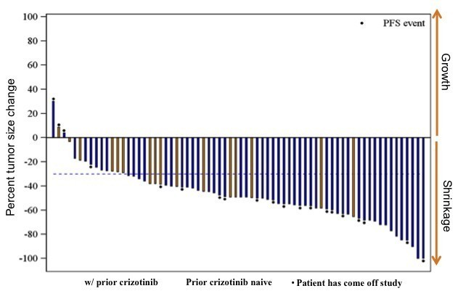
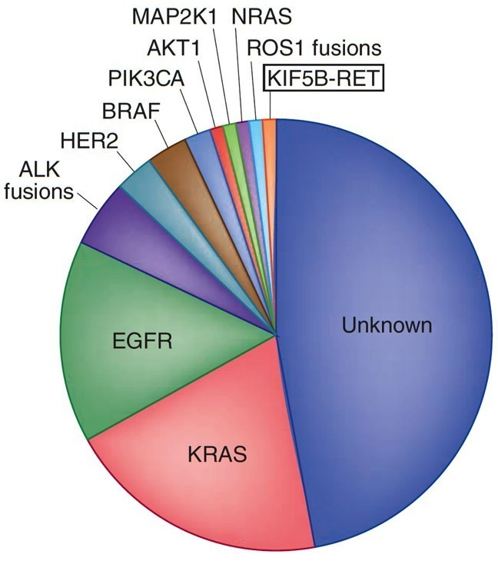
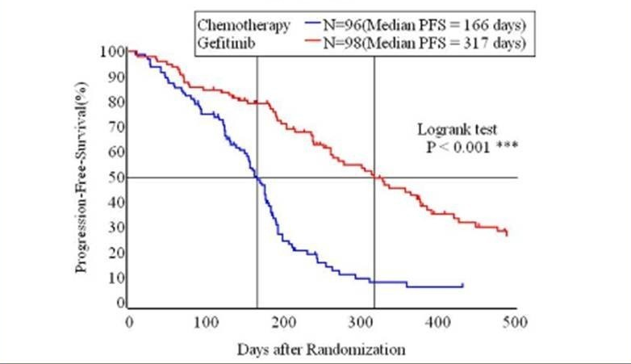
The lung cancer genome
Pao & Hutchinson Nat Med, 2012. Kobayashi, Proc ASCO, 2009. Shaw , et al. ESMO, 2012

Slide 2
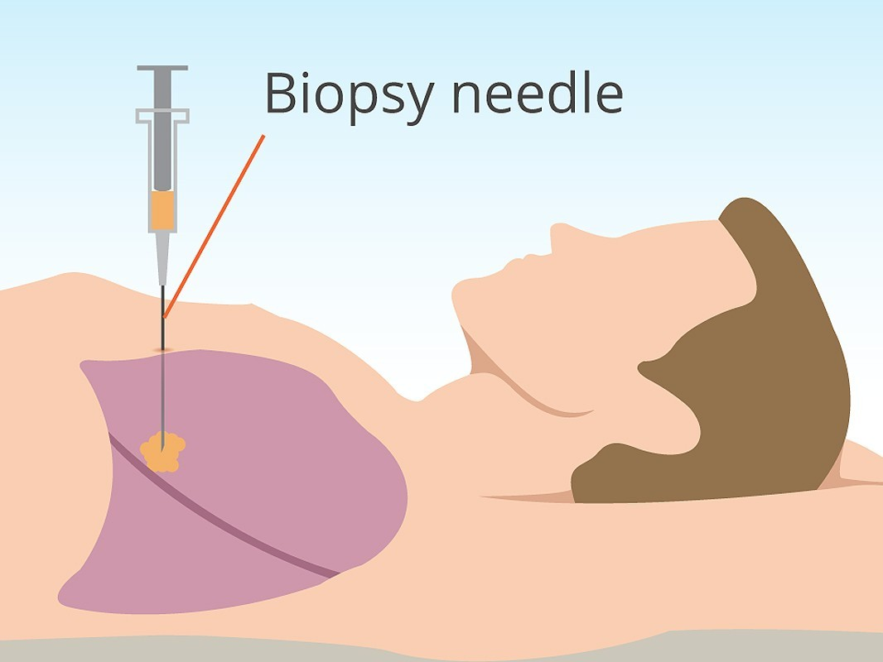
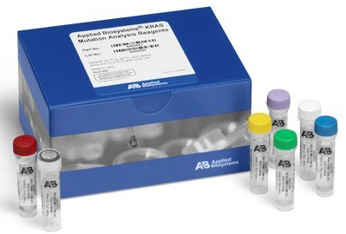
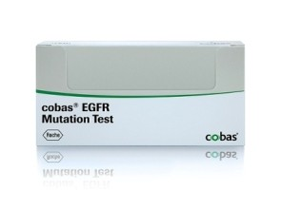
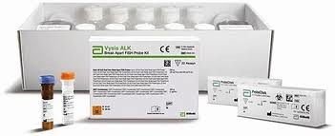
Diagnostic paradigm for lung cancer
KRAS (50ng)
EGFR (150ng)
ALK (~100ng)
‹#›

Slide 4
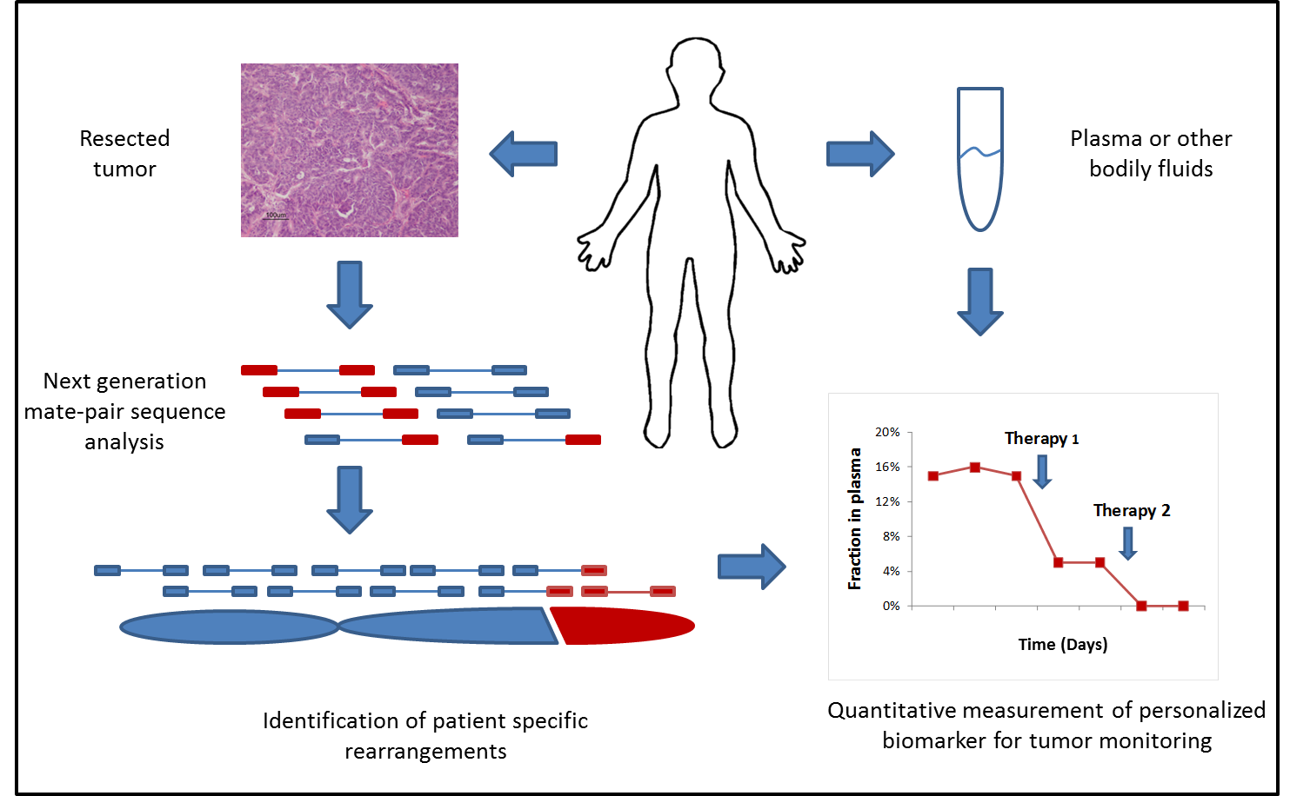

Non-invasive diagnostics
Patient sample collection and clinical decision making
Understanding individual tumor genetics to tailor therapies
What is the optimal therapy?
What is the optimal therapy?
Response?
Resistance?
Response?
Resistance?
Challenging to obtain
Frequently exhausted
Stored for years
Poor nucleic acid quality

Slide 5
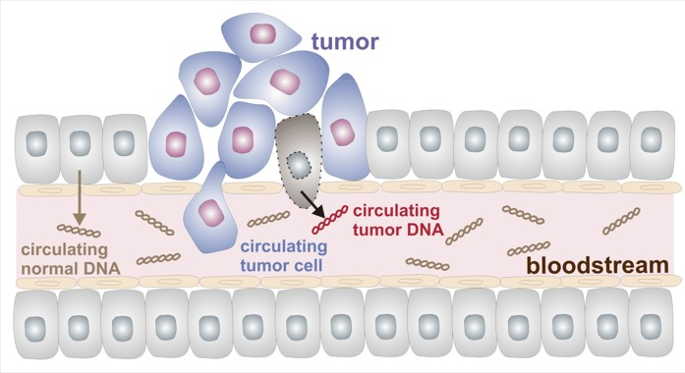
Tumor DNA in the circulation
Tumor derived DNA may be identified in total cell free DNA
Tumor cell death releases DNA into circulation
Cell free DNA comprised of both tumor and normal material

Slide 6
The promise of liquid biopsy
Utilizing cfDNA across oncology settings
Challenges of tissue-based analyses
Single-lesion sampling
Frequently exhausted or otherwise compromised
Cancers change over time
Challenging to obtain biopsies at disease progression
Opportunities of non invasive analyses
Easy access to sampling
Temporally relevant sampling
Circulating analyte may allow multi-lesion sampling

Slide 7
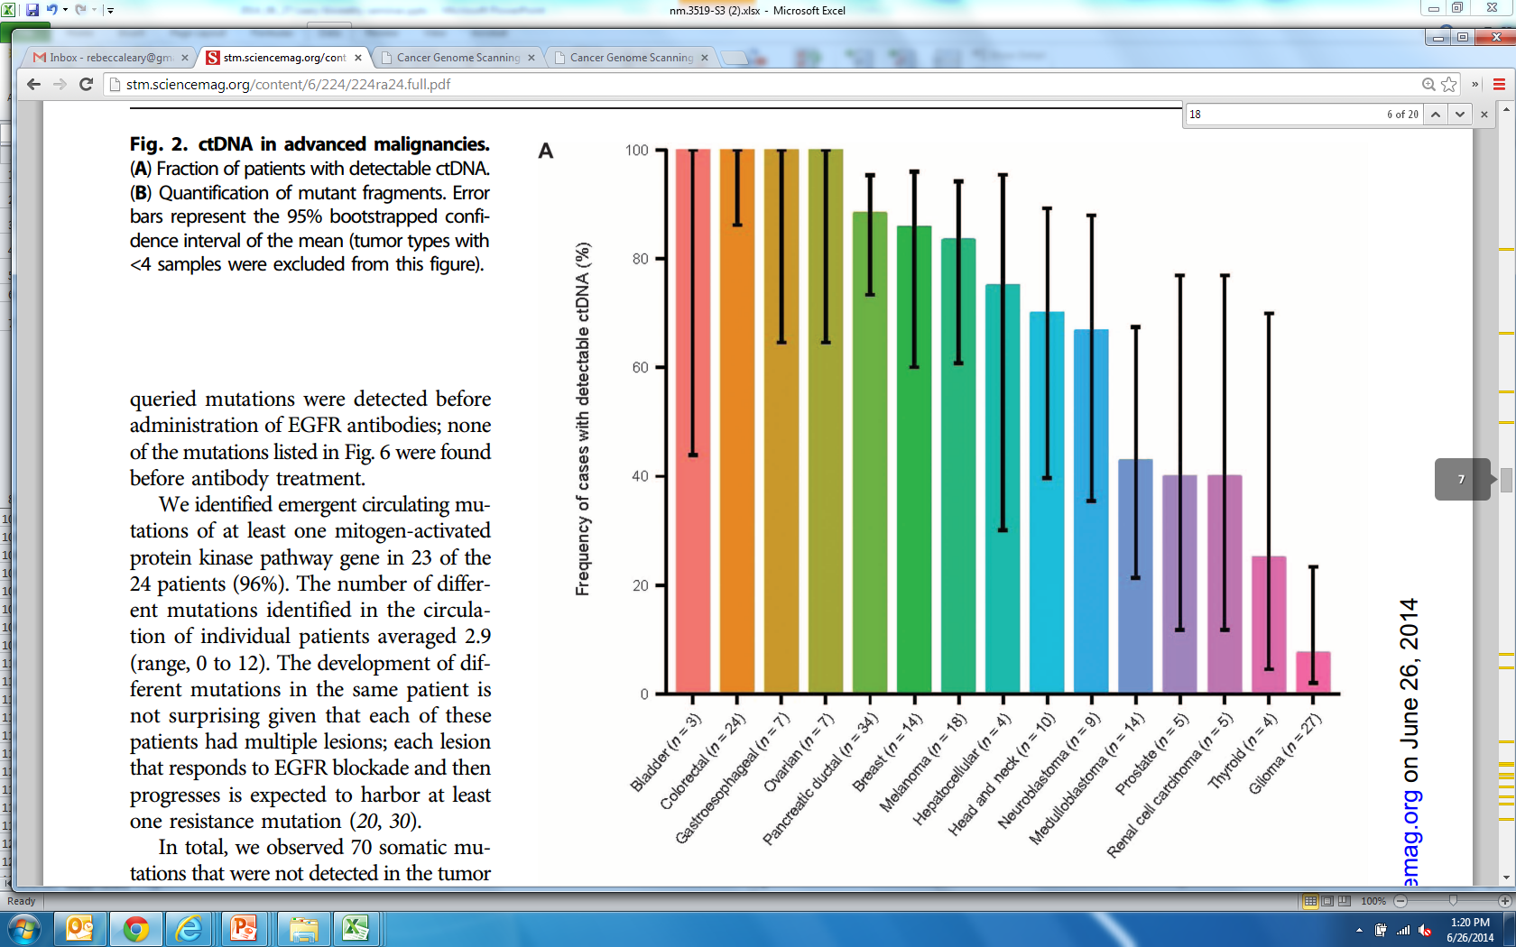
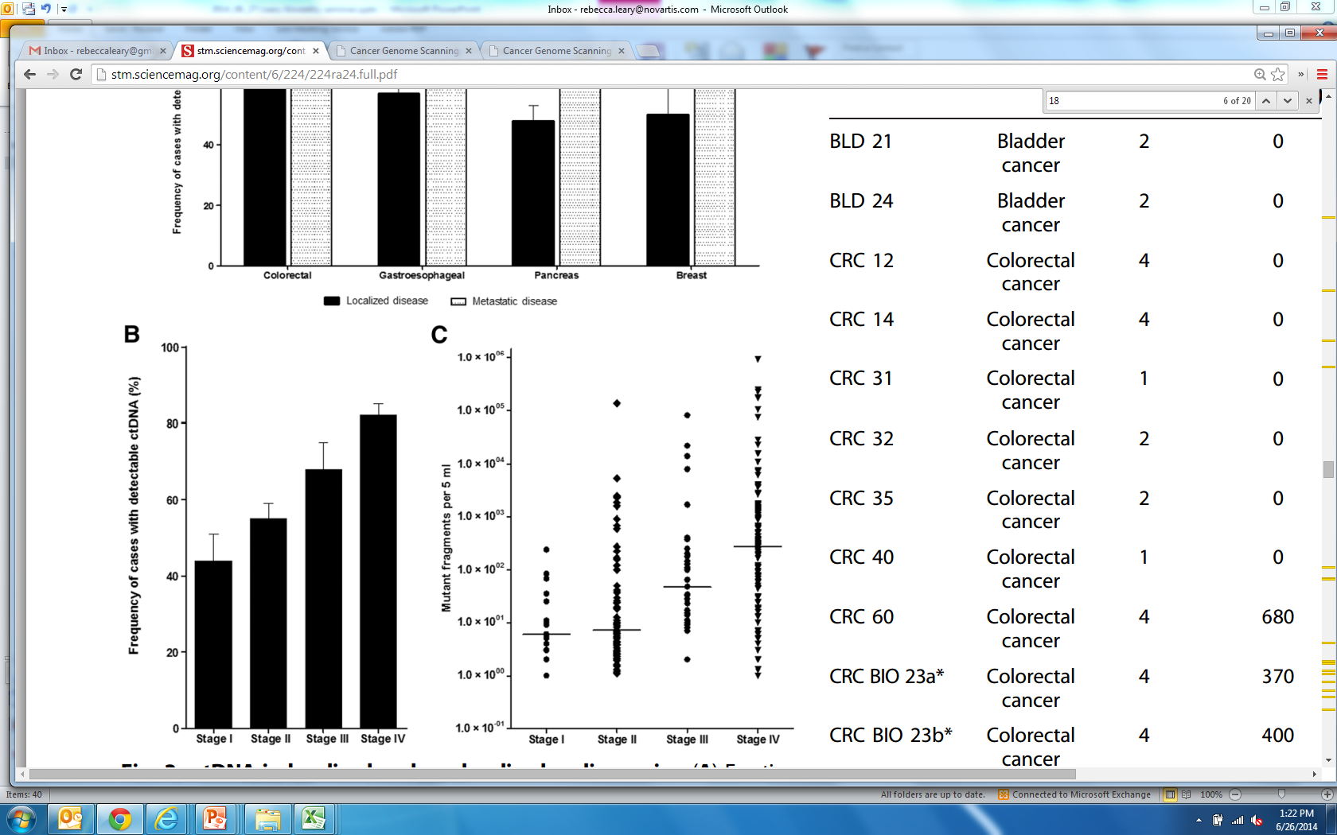
Evaluation across tumor types and stages
Bettagowda et al, Science Translational Medicine 2014
>600 patients from 18 tumors types
Detected in >75% with advanced pancreatic, ovarian, colorectal, bladder, gastroesophageal, breast, melanoma, hepatocellular, head and neck
Detected in 10-40% of primary brain, renal, prostate, or thyroid

Slide 8
The promise of liquid biopsy
Utilizing cfDNA across oncology settings
Setting | Scope
Tissue surrogate | Hotspot(s) or gene(s) of interest 1 hotspot – 10s of genes
Novel endpoints | Presence/absence of ctDNA Some prior knowledge of tumor
Early detection | Sensitivity and high specificity Tissue of origin determination
Discovery | Large panel assessment Pathways and signatures

Slide 9
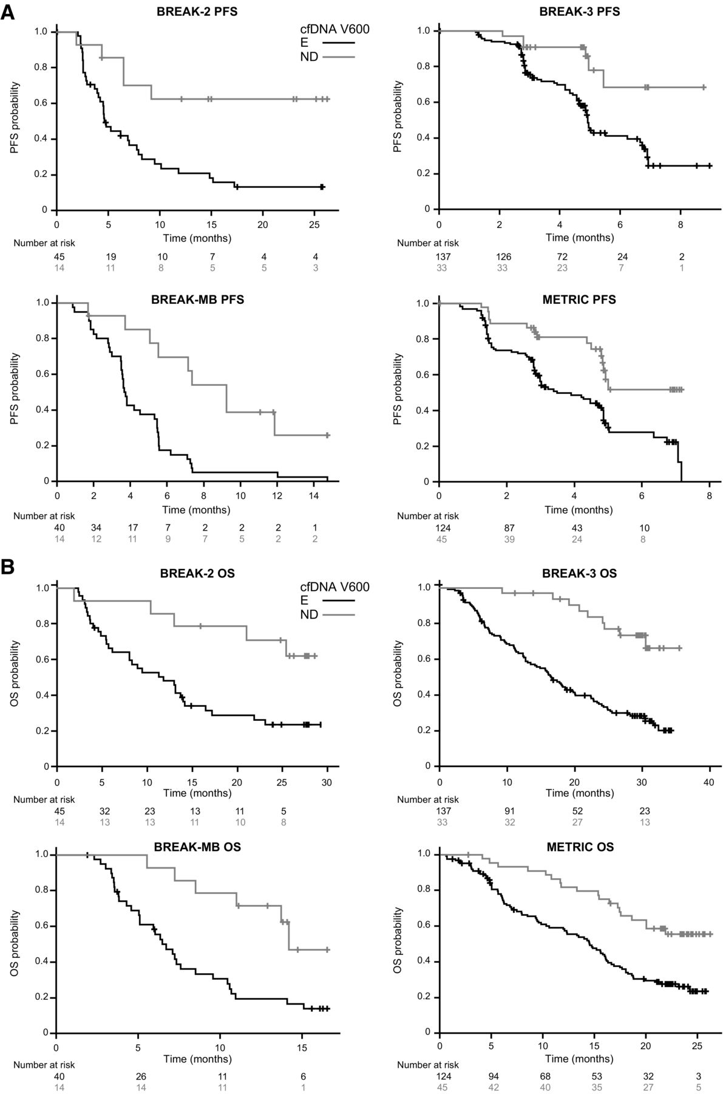
Complementary approaches Additional analyses from existing data
Santiago-Walker, et al. Clinical Cancer Research 2016
Mutation burden and mutation signatures
Sub-clone identification
Estimates of tumor contribution to the circulation
Nucleosome positioning to back calculate expression
Non-human sequences

Slide 10
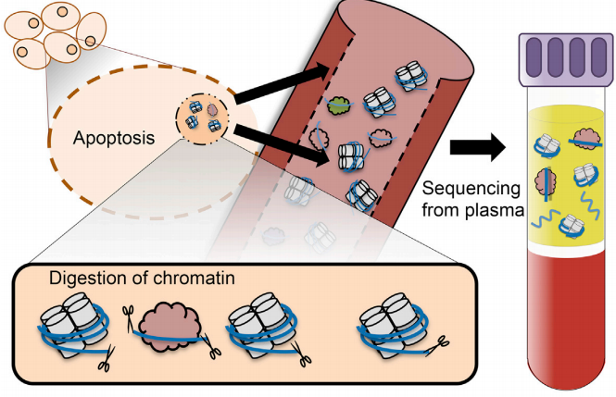
Complementary approaches Additional analyses from existing data
Snyder et al. Cell 2016
Mutation burden and mutation signatures
Sub-clone identification
Estimates of tumor contribution to the circulation
Nucleosome positioning to back-calculate expression
Non-human sequences

Slide 11
Complementary approaches Integrating cfDNA with other analytes
Move towards total nucleic acid analyses
Increased signal for SNV detection, amplicon directed Txns
CTCs
Protein
miRNAs
Circulating exosomes (total and sorted)
Tissue-based analyses
Autopsy sets
IO markers
Notes:
Relevance to IO therapies (macrophage depletion of cellular debris)

Slide 12
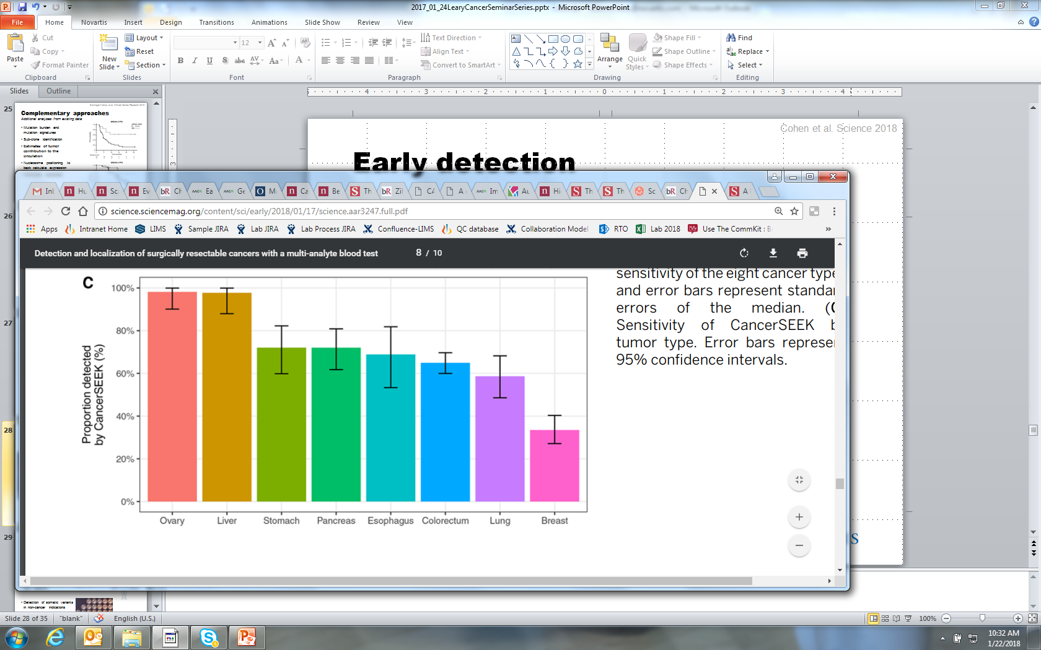
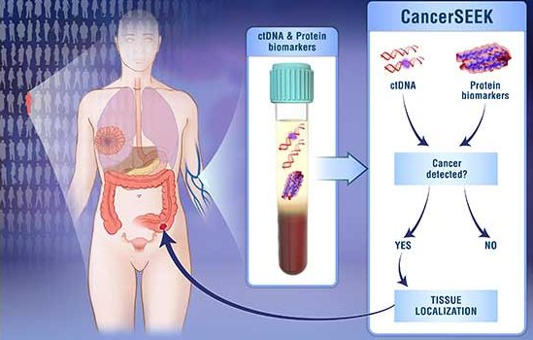
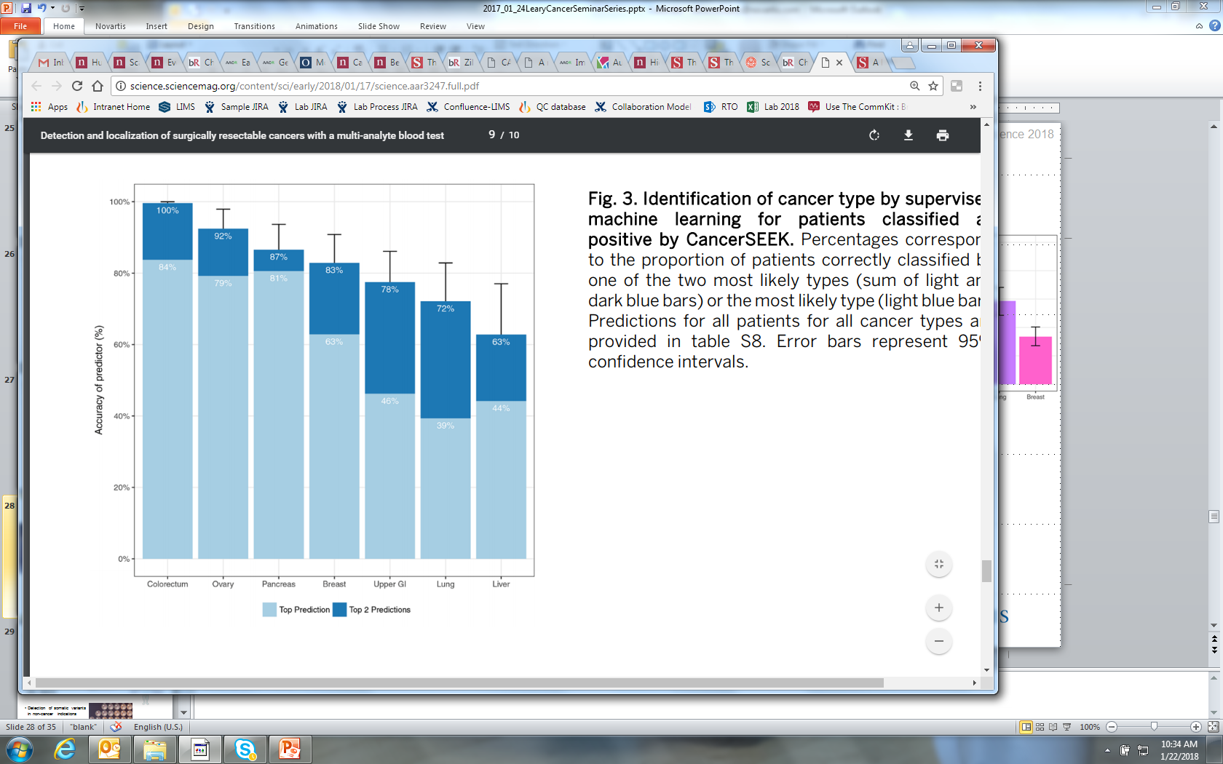
Early detection
Cohen et al. Science 2018
Ovary Liver Gast Panc Esoph CRC Lung Breast
Plasma: 7.5ml 🡪 cfDNA, ~1ml 🡪 protein
16 gene Safe-SeqS panel
61 amplicons, 2kb territory
2 non-overlapping primer pools
8 proteins
7 Luminex immunoassay panels
39 total proteins
Notes:
61-amplicon panel, with each amplicon querying an average of 33 bp within one of 16 genes

Slide 13
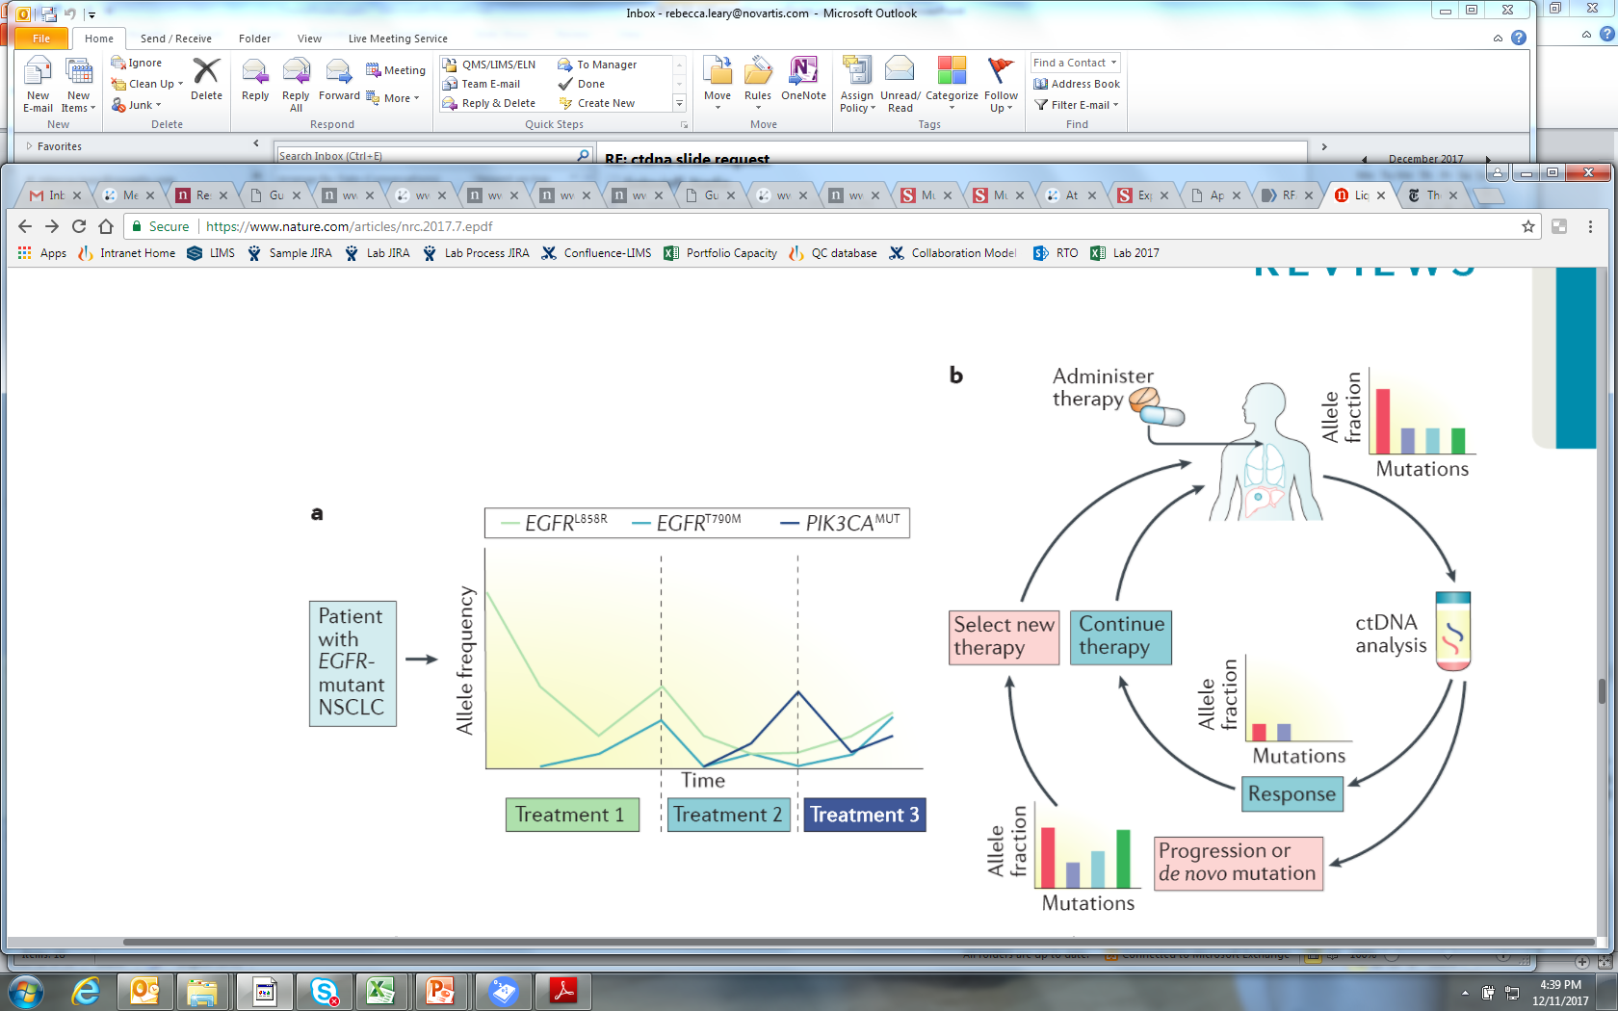
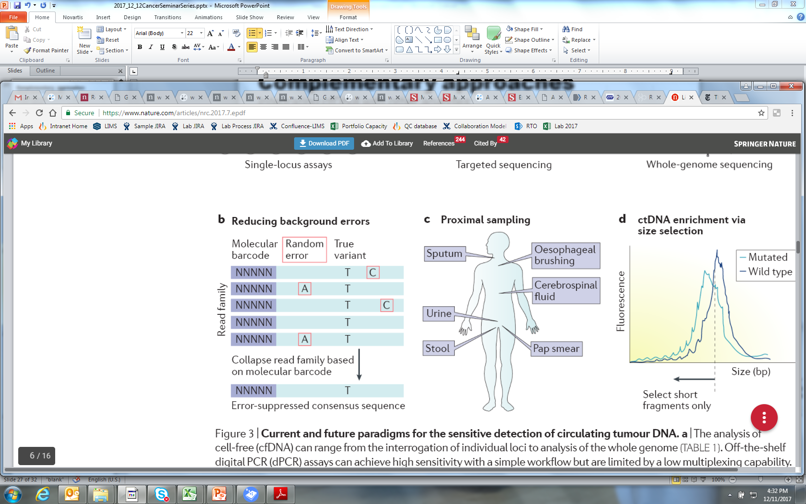
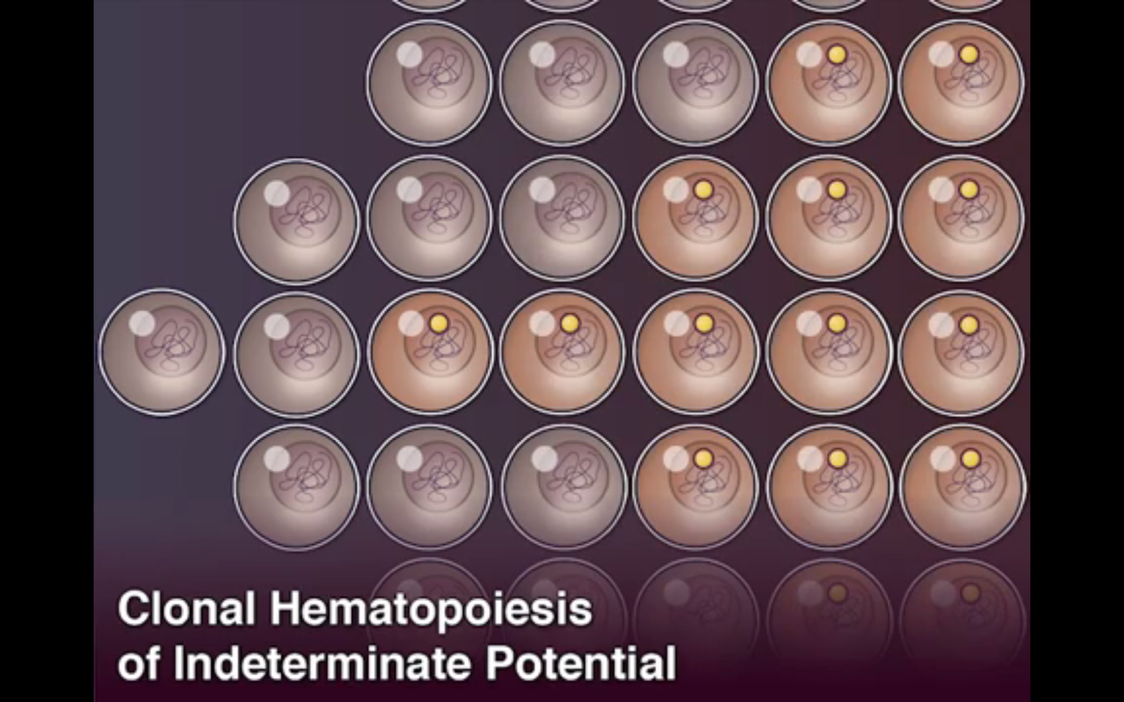
Future developments
Clinical trial design
Regulatory approval
Incorporation of complementary biofluids
Early detection
Detection of somatic variants in non-cancer indications

Slide 14
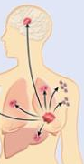
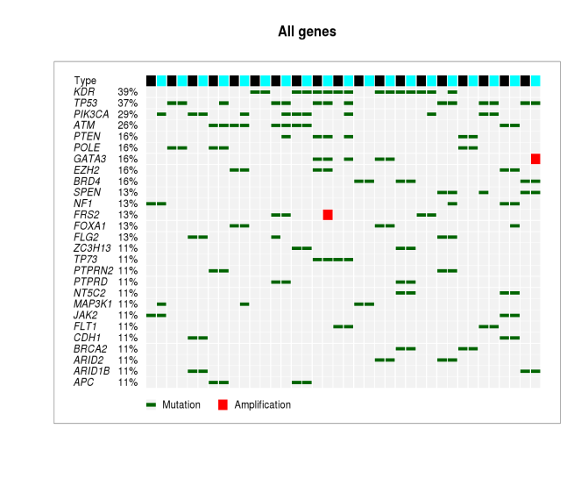
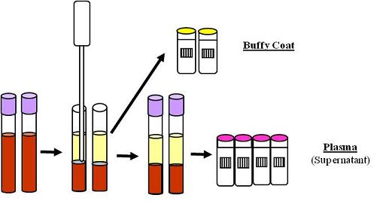
cfDNA hybrid capture NGS assay
Broad profiling of cancer lesions in cfDNA
At Novartis, we have developed, optimized, and validated a 600 gene assay to characterize cell-free DNA
Tumor
Normal DNA
Plasma
Short variant
Tumor DNA
Amplification
600 gene panel
Cancer genes and pathways
SNVs, CNVs, Translocations

Slide 15
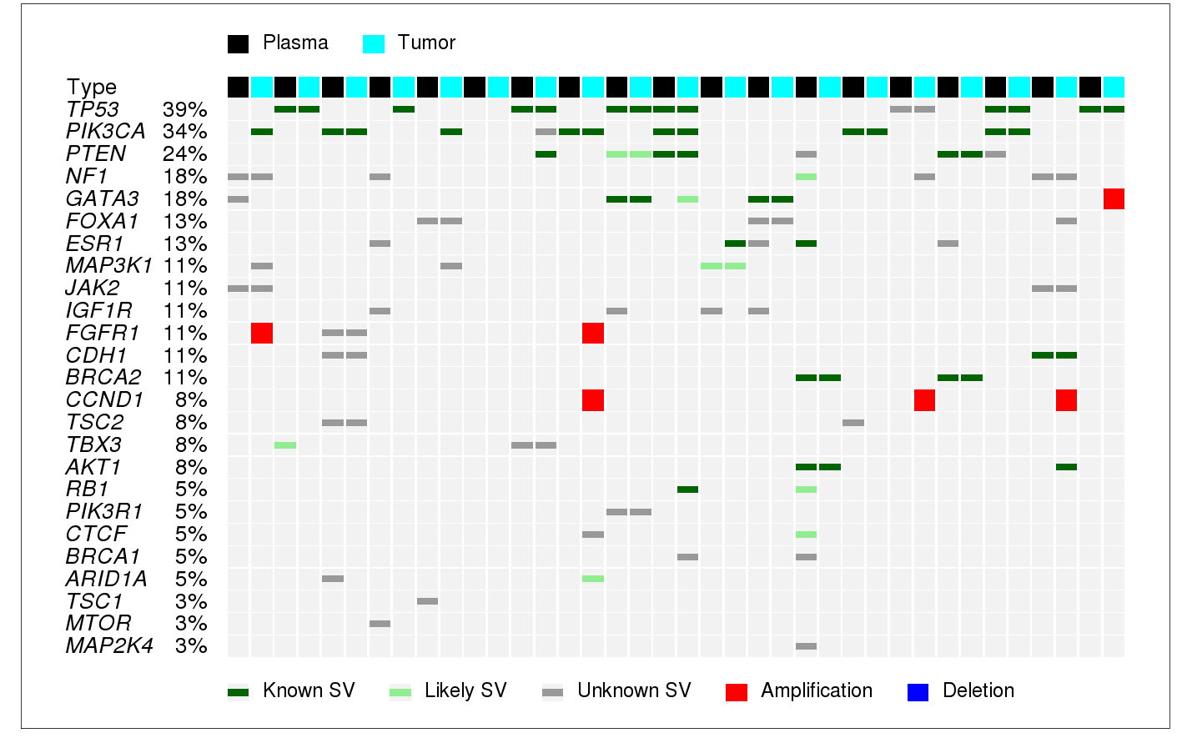
Description of mutation landscape
Plasma-tumor pairs from late stage breast cancer

Slide 16
Description of mutation landscape
ESR1 has more mutations in plasma than in tumor
‹#›

Slide 17
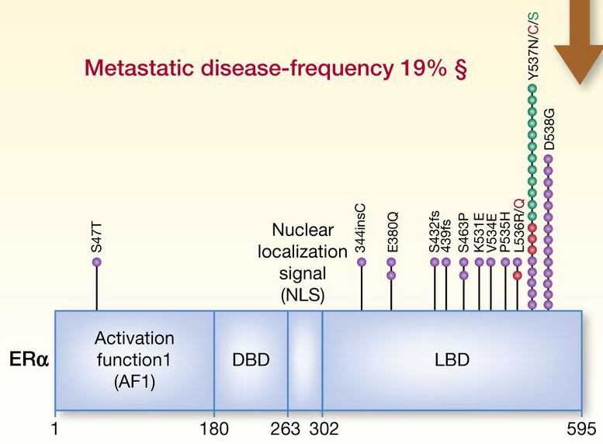
Resistance lesions detected in plasma
Segal and Dowsett Clin Cancer Res 2014
ESR1 alterations mediate resistance hormone therapy
Amino acid change | Plasma % mutant | Detected in tumor
T4I | 1.2 | low
E380Q | 4.7 | no
LY536PS | 15.0 | --
L536R | 0.7 | no
D538G | 4.0 | --
D538G | 0.2 | yes
D538G | 1.6 | no
R555C | 50.0 | --
Detection of acquired endocrine resistance lesion directly from plasma

Slide 18
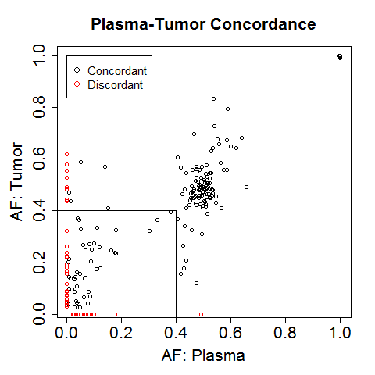
Tumor-plasma concordance
Depends on time elapsed between tissue and plasma collection
Time elapsed between collections | Variants detected in tumor | Detected in plasma
 |  | N | Fraction
Any | 85 | 57 | 0.67
5-15 years | 30 | 15 | 0.50
<1 year | 55 | 42 | 0.76
Time elapsed between collections | Variants detected in plasma | Detected in tumor
 |  | N | Fraction
Any | 64 | 42 | 0.66
5-15 years | 27 | 11 | 0.41
<1 year | 37 | 31 | 0.84
cfDNA has higher concordance with recently collected tumor tissue
Suggests that changes in tumors over time are reflected in cfDNA
Notes:
Concordance of variants with AF < 0.40

Slide 19
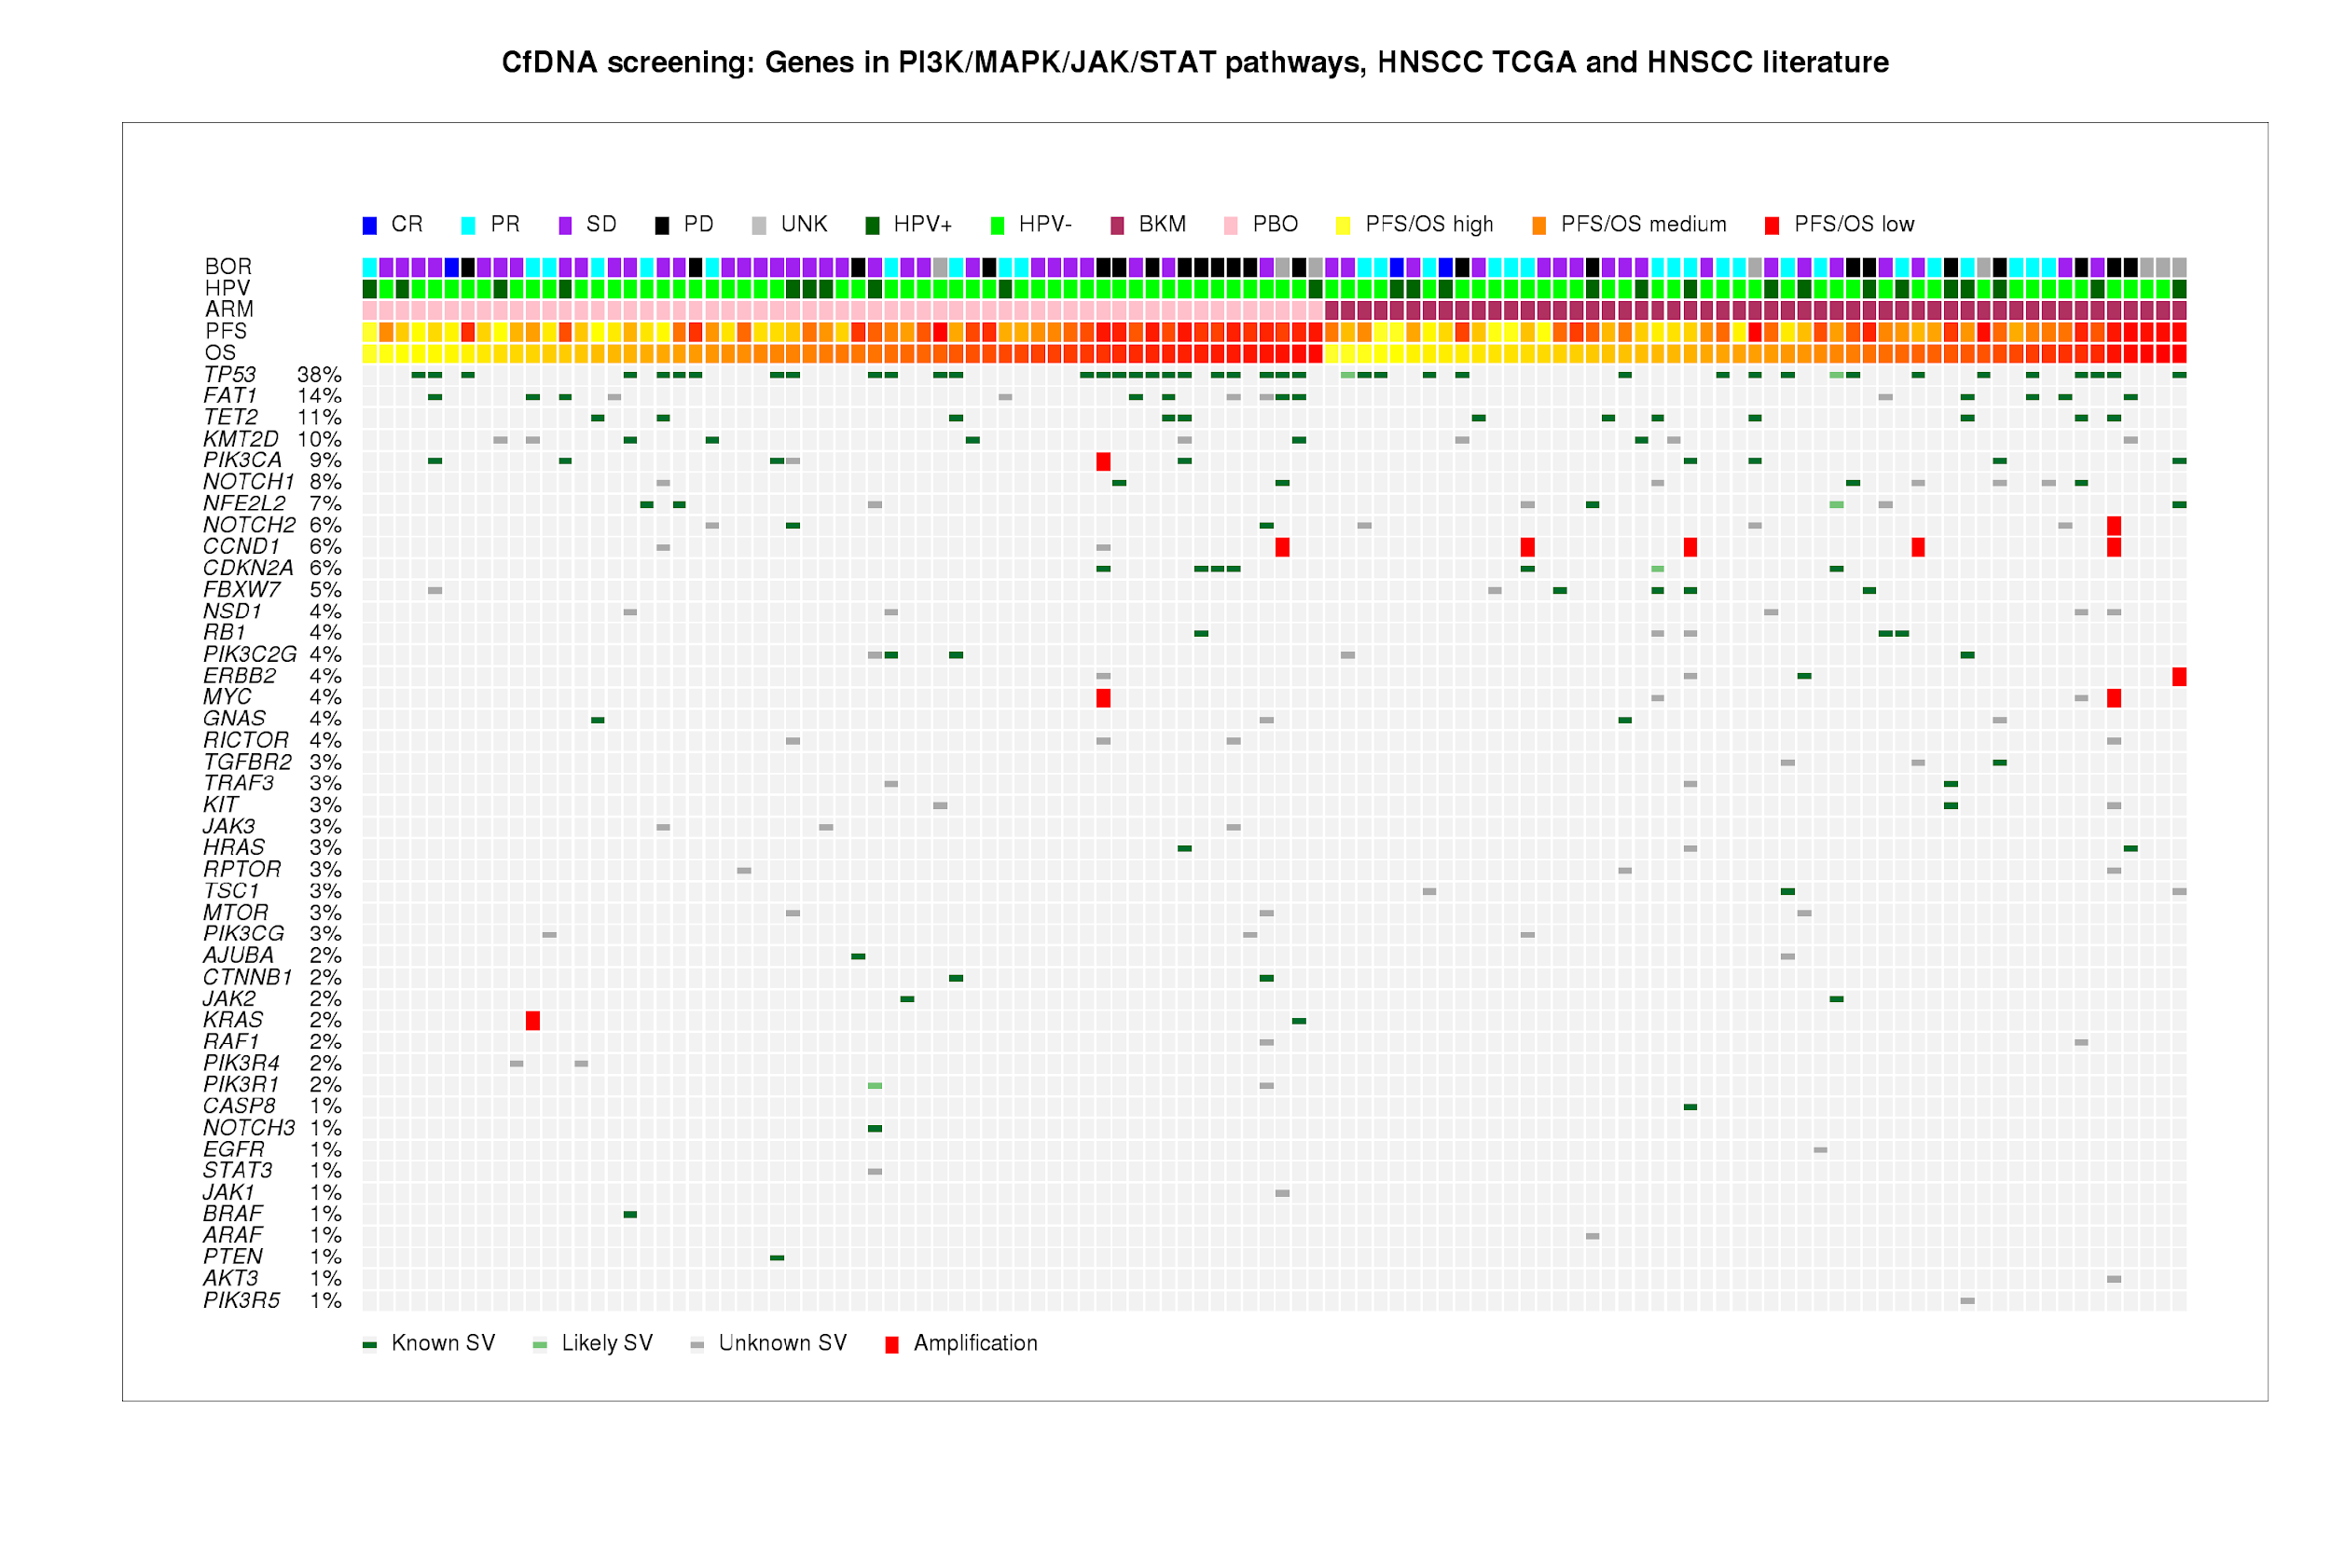
Comprehensive panel enables biomarker development
Licitra et al, ASCO 2016
Notes:
Paclitaxel +/- BKM120 in recurrent or metastatic HNSCC
BERILl1: BKM120 in recurrent or metastatic HNSCC
112 pts at screening

Slide 20
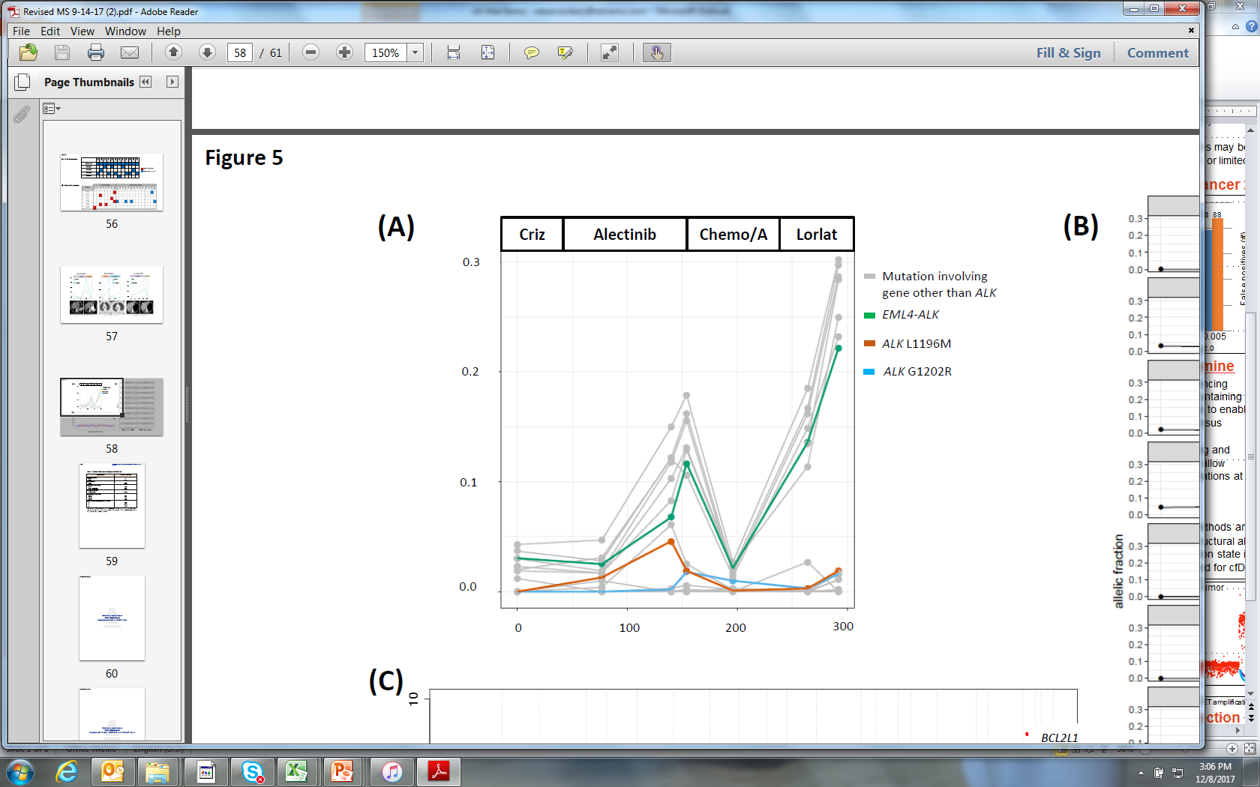
Understanding cancer biology Resistance heterogeneity
Dagogo-Jack, Brannon, et al. JCO Precision Onc. 2018
Longitudinal assessment of ALK⁺ NSCLC
Multiple possible mechanisms of resistance
Amplification of AML4-ALK driving progression on lorlatinib
cfDNA mutant allelic fraction
Days
Notes:
Quantify changes in mutant allelic fraction as a surrogate for response
Identify changes in tumor genotype: emergence of resistant clones and relative changes in multiple subpopulations

Slide 21
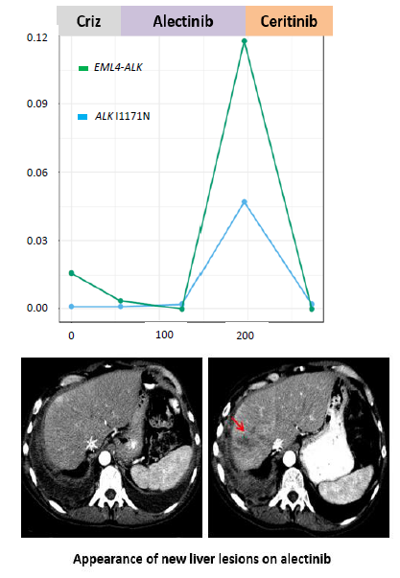
Understanding cancer biology Treating resistance
Dagogo-Jack, Brannon, et al. JCO Precision Onc. 2018
ALK I1171N mutation detected at progression on alectinib
ALK mutation not present during treatment with crizotinib
Ceritinib initiated 🡪 radiographic and molecular response
Decrease in ALK I1171N AF 4.5% to undetectable after six weeks
cfDNA mutant allelic fraction
Days
Notes:
Quantify changes in mutant allelic fraction as a surrogate for response
Identify changes in tumor genotype: emergence of resistant clones and relative changes in multiple subpopulations

Slide 22
cfDNA evaluation in cancer
Leon et al, 1977; Sidransky et al, 1991; Kopreski et al, 1997; Dressman et al, 2003; Fan et al, 2008; Kinde et al, 2011; Murtaza et al, 2012
A brief history
Proofs of concept
1977 – cancer patients have increased levels of total plasma DNA
1991 – p53^{mut} found in urine from bladder cancer patients
1997 – KRAS^{mut} identified in plasma of colorectal cancer patients
Era of cfDNA specific technology development
2003 – BEAMing for digital evaluation of point mutations
2008 – Shotgun sequencing of cell free DNA
2011 – Safe-SeqS for digital sequencing of small amplicon panels
2013 – Exome sequencing of cell free DNA
2016 – First cell free DNA assay approved by the FDA

Slide 23
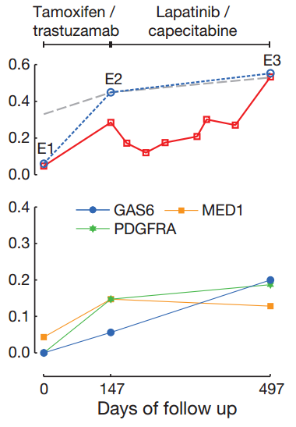
Resistance in breast, ovarian, and lung cancers
Murtaza et al, Nature 2013
Direct exome sequencing (30-160x) of serial plasma samples
Identify mutations selected for by treatment
Demonstrated unbiased identification of candidate mechanisms of resistance
🡨 exome
Allele frequency
targeted amplicon sequencing of ATM
Allele frequency
Allele frequencies from exome data

Slide 24
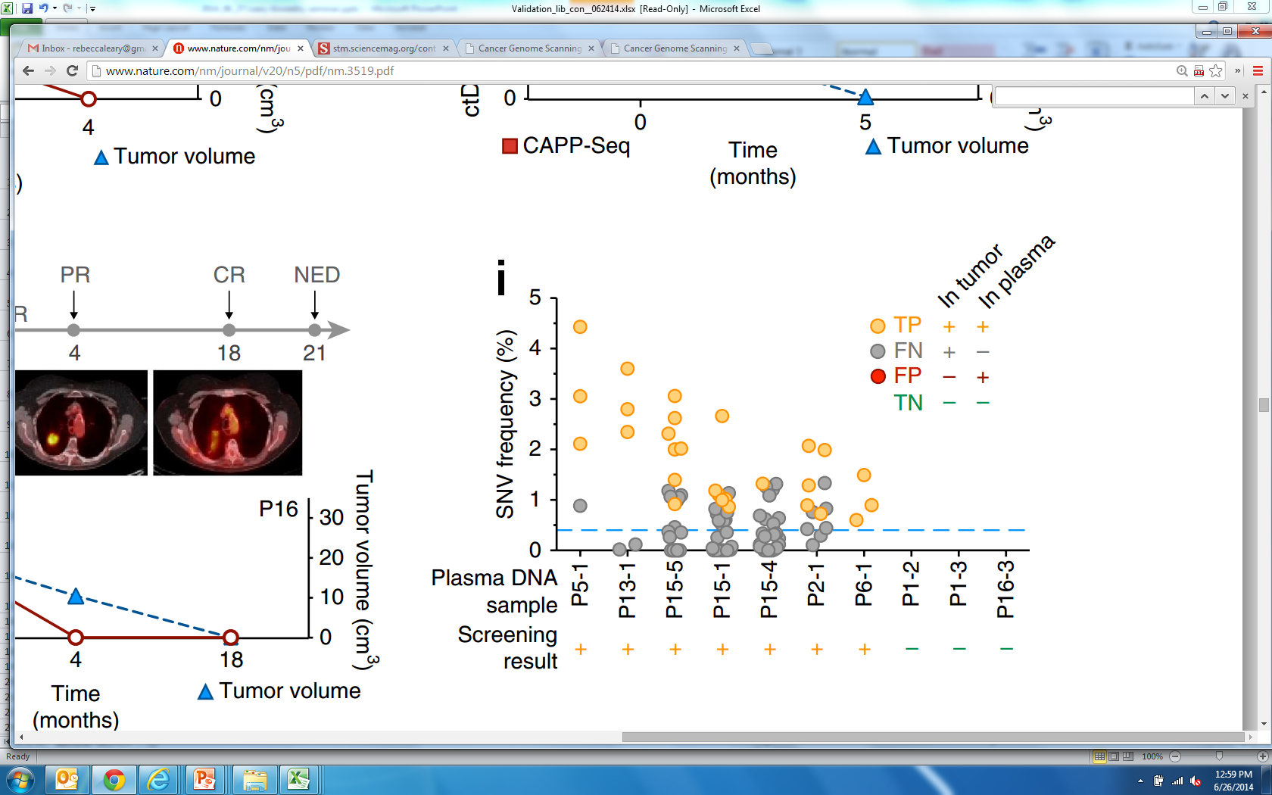
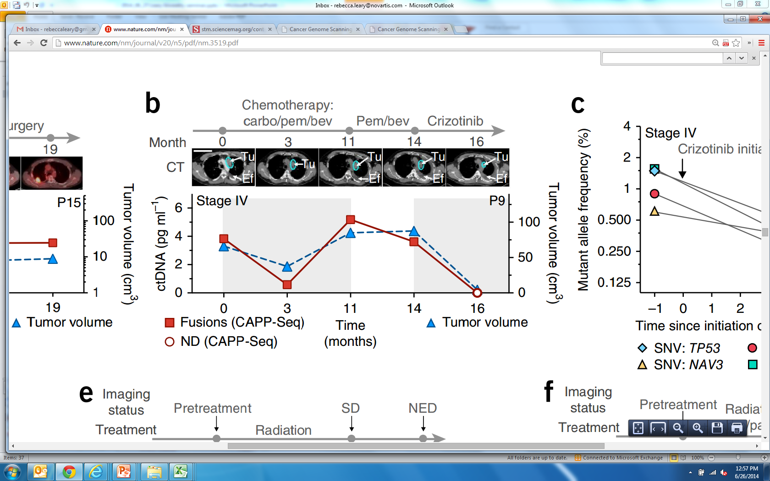
Liquid biopsy in lung cancer
Newman et al, Nature Medicine 2014
Panel captures targets from 139 recurrently mutated genes 🡪 NGS
Serial plasma samples 🡪 disease monitoring
Genotyping from plasma to 0.4% ctDNA

